Slide 1

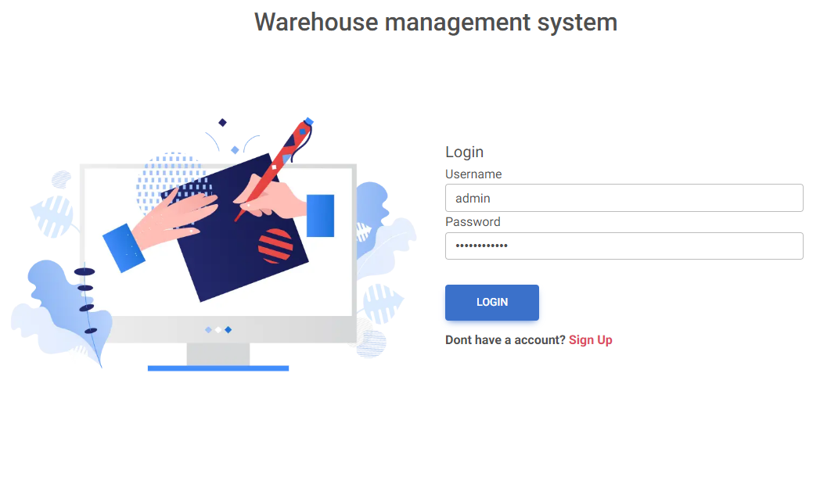
Warehouse Management System
tuwaiq academy

Slide 2
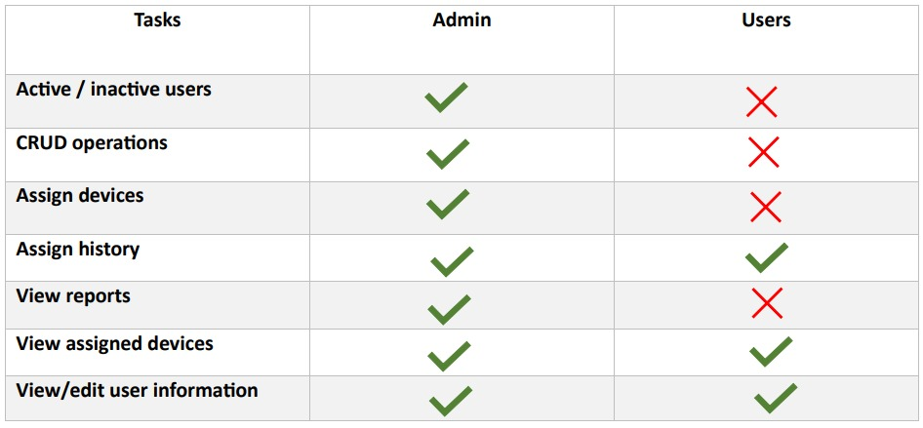
Users Features

Slide 3
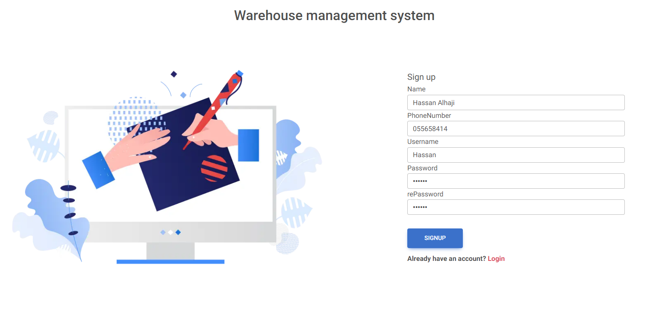
Users Registration

Slide 4
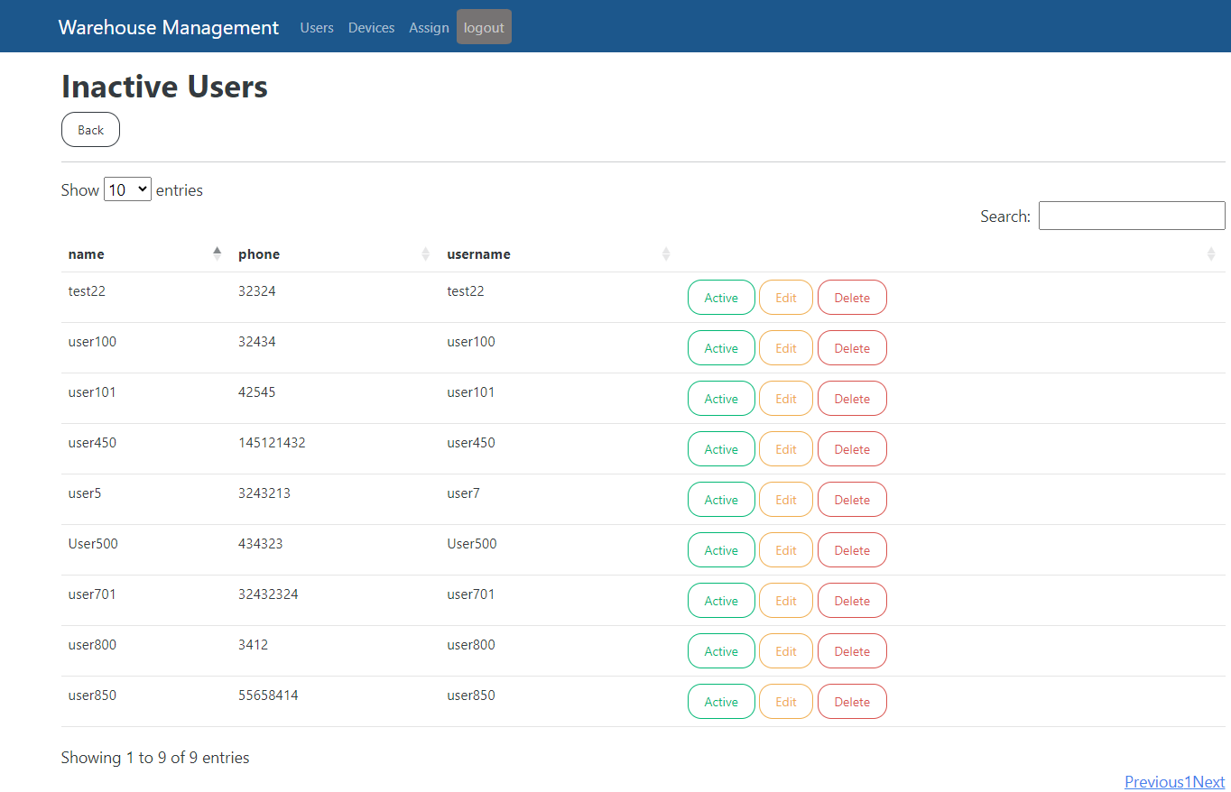
Activate Users

Slide 5
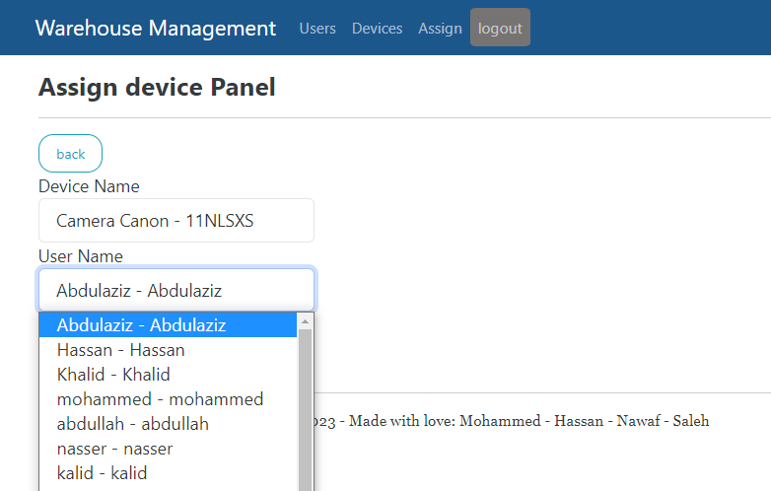
Assign device

Slide 6
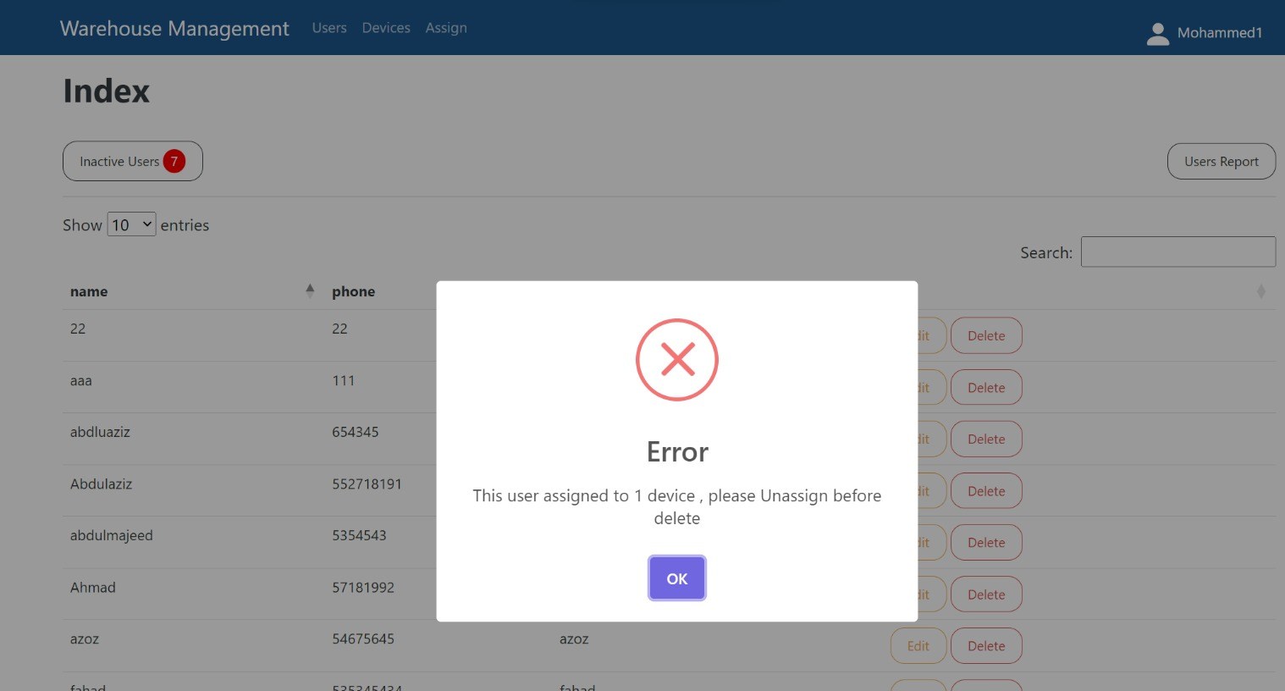
Delete Users

Slide 7
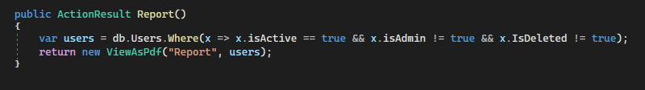
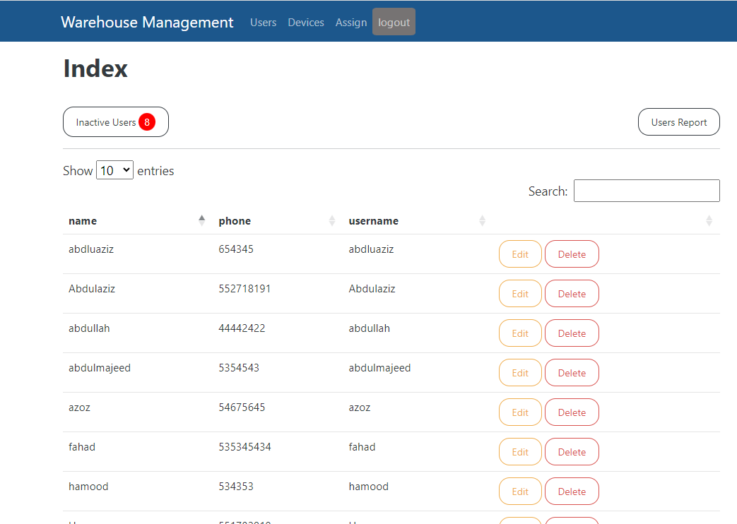
Print Report

Slide 8
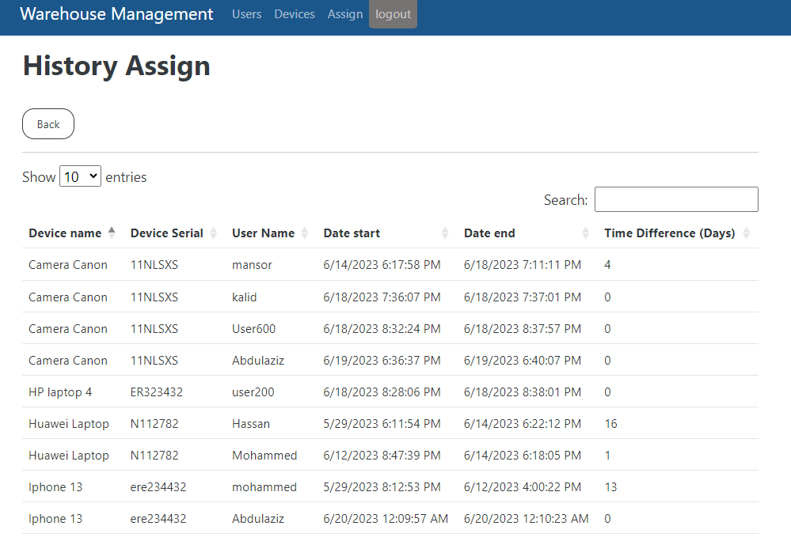
Logs

Slide 9
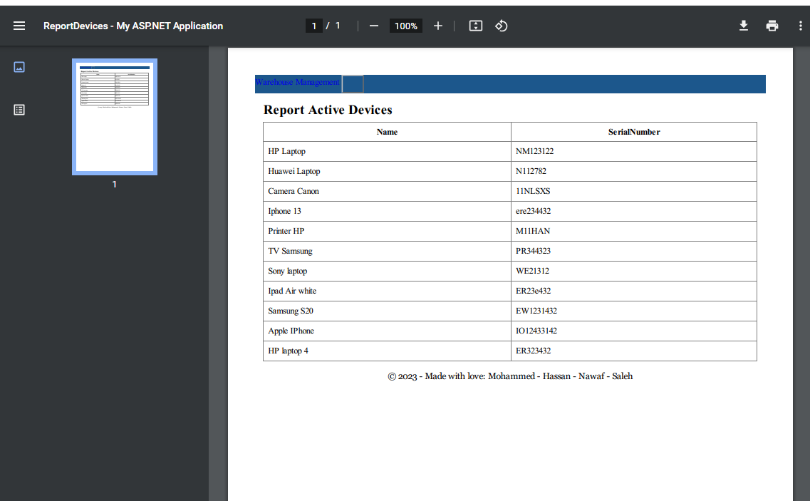
Report

Slide 10
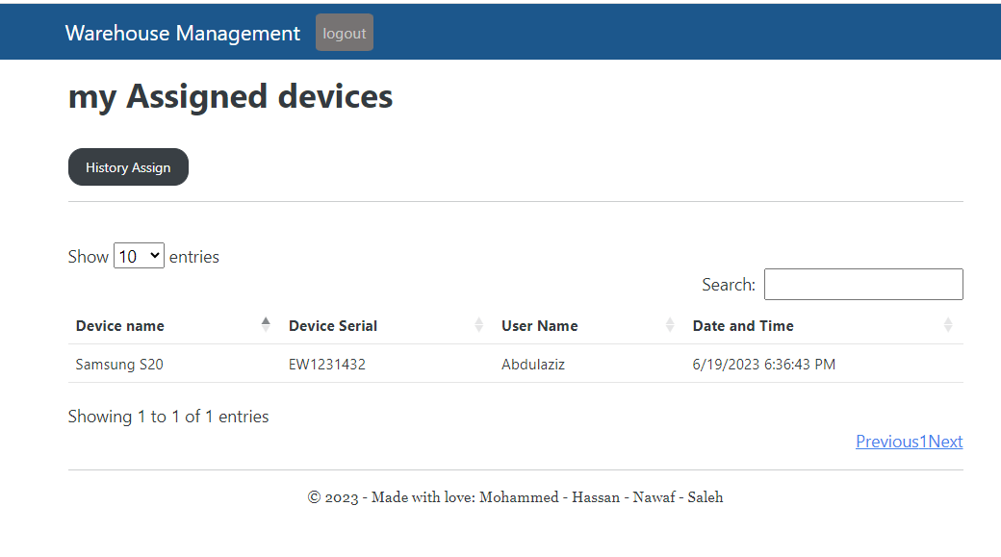
User Panel

Slide 11
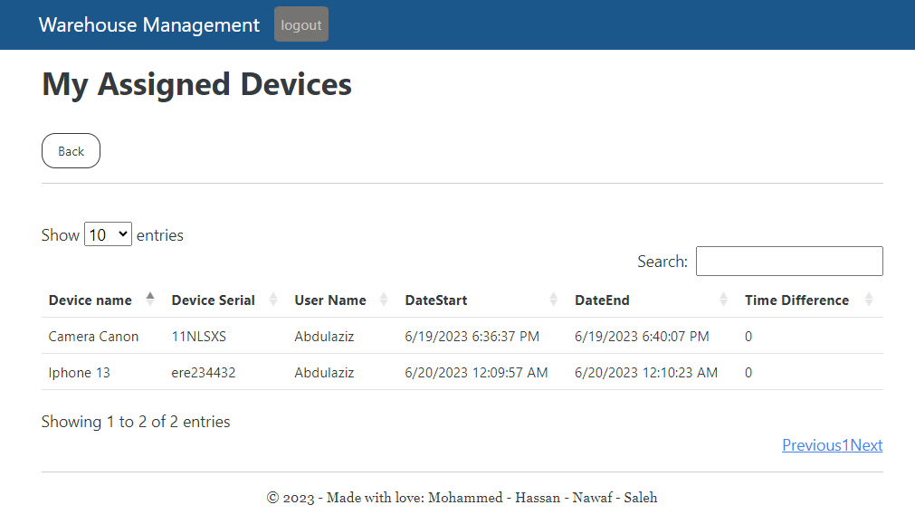
User Panel

Slide 12

Thank You
Mohammed Alotaibi
Hassan Al-haji
Nawaf Al-dossary
Saleh Al-Shehri

